Slide 1
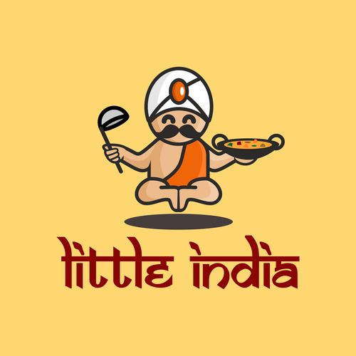
Little India

Slide 2
Introduction
The restaurant LittleIndia introduced authentic and traditional Indian food to the customers. It offers a vast variety of delectable and exotic vegetarian and non-vegetarian dishes that are prepared with varied traditional culinary styles.

Slide 3
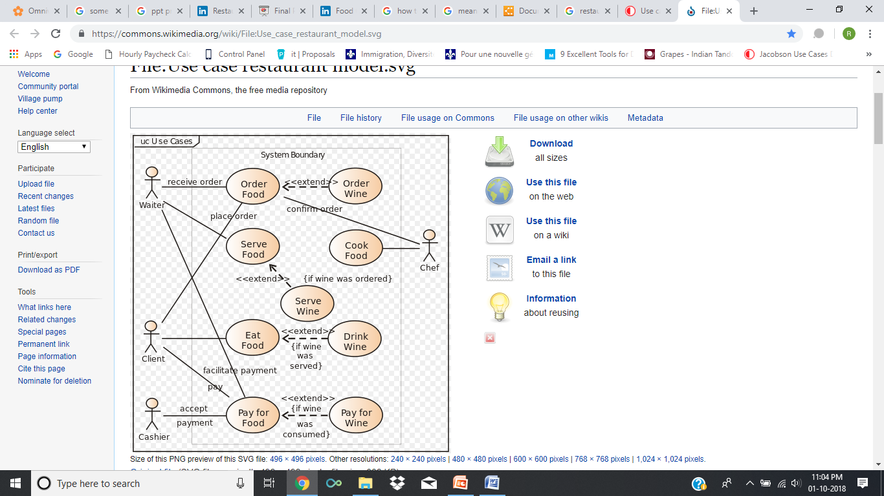
UML Structure Of App:

Slide 4
Purpose:
Restaurants Apps are making foods available anywhere and everywhere. These apps remain helpful when you are not able to travel to buy food. Restaurant Apps with Mobile Food Ordering is now available, affordable and scalable.
A restaurant app, aimed at restaurant’s operation processes can increase customer loyalty, decrease entry errors and get it into a time.

Slide 5

Target Audience

Slide 6

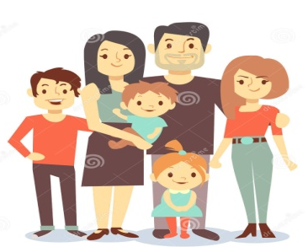


Who will use our App:
Children
Families –weekend outings or meals
Students
Working adults-seek convenience meals

Slide 7
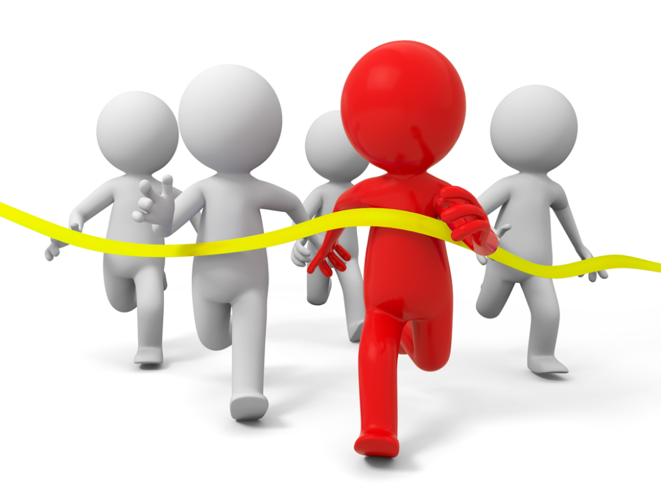
Competitors

Slide 8
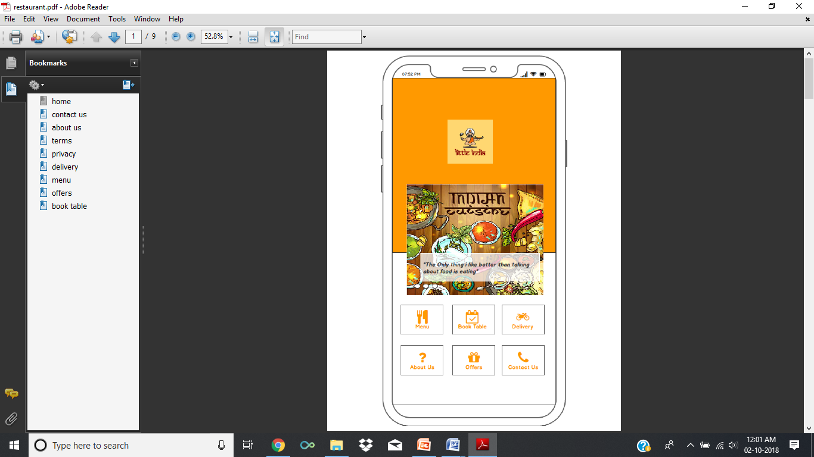
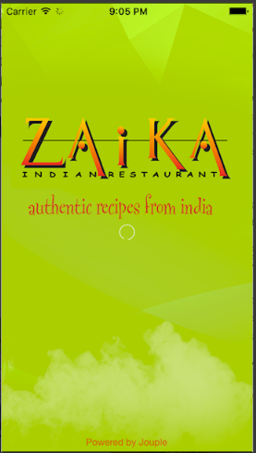
Zaika :- Design of this app is not attractive and good
Litte India

Slide 9
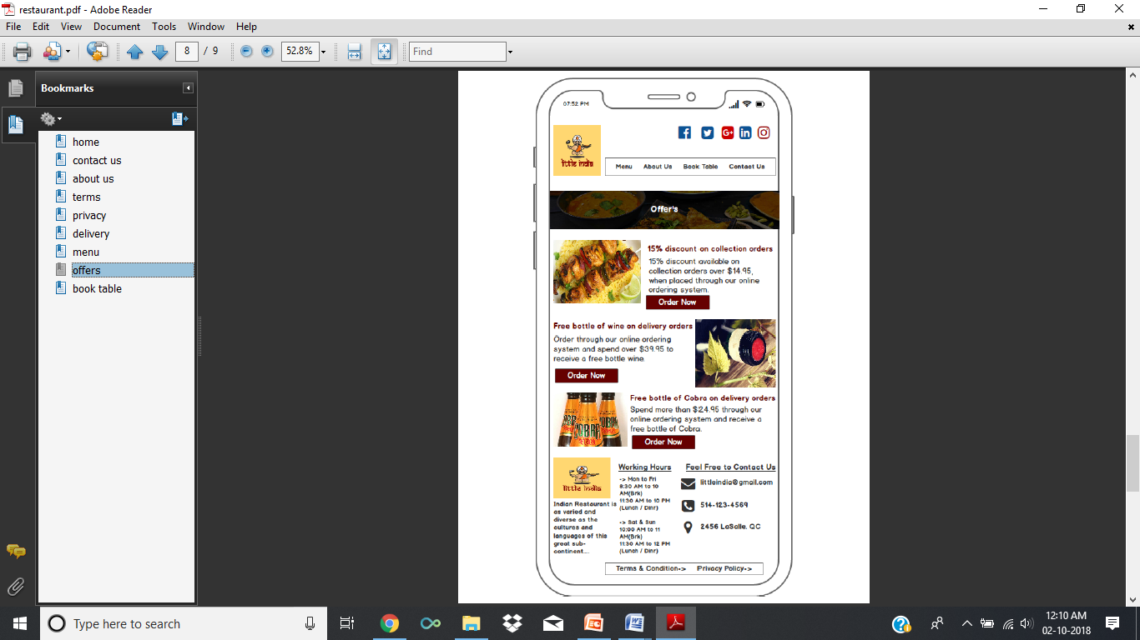
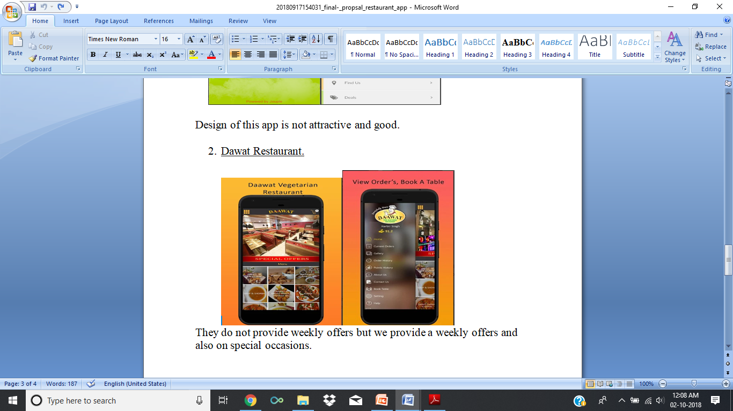
Dawat Restaurant :- They do not provide weekly offers but we provide a weekly offers and also on special occasions.
Litte India :-

Slide 10

Our Team

Slide 11
Who made what :-
Rajbir Kaur :- Wireframe
Varinder Kaur :-
Manpreet Singh :-
Amarjeet Singh :-
Raman Kumar Verma :- Designing & UML.

Slide 12
Thanks

